Slide 1

Text Classification

Slide 2
Natural Language Processing Bootcamp
Section Goals
Understand Machine Learning Basics
Understand Classification Metrics
Understand Text Feature Extraction
Familiarize ourselves with Scikit-Learn and Python to perform text classification on real data sets.

Slide 3
Natural Language Processing Bootcamp
Keep in mind, we start with quite a few “theory” lectures, we won’t code anything until we have a solid understanding of Machine Learning, Classification, and Text Feature Extraction concepts.
Let’s get started!

Slide 4
Machine Learning Overview

Slide 5
Natural Language Processing
Before we dive into Text Classification, let’s work on understanding the general machine learning process we will be using.
The specific case of machine learning we will be conducting is known as supervised learning

Slide 6
Machine Learning
Because different students have different backgrounds in math, we will keep the mathematics behind the machine learning algorithms light.

Slide 7
Machine Learning
A great textbook on general machine learning is Introduction to Statistical Learning by Gareth James as a companion book.
It’s freely available online. Simply google search the title of the book.

Slide 8
What is Machine Learning?
Machine learning is a method of data analysis that automates analytical model building.
Using algorithms that iteratively learn from data, machine learning allows computers to find hidden insights without being explicitly programmed where to look.

Slide 9
What is it used for?
Fraud detection.
Web search results.
Real-time ads on web pages
Credit scoring and next-best offers.
Prediction of equipment failures.
New pricing models.
Network intrusion detection.
Recommendation Engines
Customer Segmentation
Text Sentiment Analysis
Predicting Customer Churn
Pattern and image recognition.
Email spam filtering.

Slide 10
Supervised Learning
Supervised learning algorithms are trained using labeled examples, such as an input where the desired output is known.
For example, a segment of text could have a category label, such as:
Spam vs. Legitimate Email
Positive vs. Negative Movie Review

Slide 11
Supervised Learning
The learning algorithm receives a set of inputs along with the corresponding correct outputs, and the algorithm learns by comparing its actual output with correct outputs to find errors.
It then modifies the model accordingly.

Slide 12
Supervised Learning
Supervised learning is commonly used in applications where historical data predicts likely future events.

Slide 13
Machine Learning Process
Test
Data
Model
Training &
Building
Data
Acquisition
Data
Cleaning
Model
Testing
Model
Deployment

Slide 14
Machine Learning Process
Get your data! Customers, Sensors, etc...
Data
Acquisition

Slide 15
Machine Learning Process
Clean and format your data (using SciKit Learn and Vectorization)
Data
Acquisition
Data
Cleaning

Slide 16
Machine Learning Process
Test
Data
Training
Data
Data
Acquisition
Data
Cleaning

Slide 17
Machine Learning Process
Test
Data
Model
Training &
Building
Data
Acquisition
Data
Cleaning

Slide 18
Machine Learning Process
Test
Data
Model
Training &
Building
Data
Acquisition
Data
Cleaning
Model
Testing

Slide 19
Machine Learning Process
Test
Data
Model
Training &
Building
Data
Acquisition
Data
Cleaning
Model
Testing

Slide 20
Machine Learning Process
Test
Data
Model
Training &
Building
Data
Acquisition
Data
Cleaning
Model
Testing
Model
Deployment

Slide 21
Supervised Learning
Text classification and recognition is a very common and widely applicable use of machine learning.
Later on we will learn about the SciKit-Learn Library in order to use Python to conduct machine learning text classification!

Slide 22
Model Evaluation
Let’s take a moment to focus on the train/test split that occurred and learn a few terms.
Let’s imagine a full data set of Ham vs Spam text messages.

Slide 23
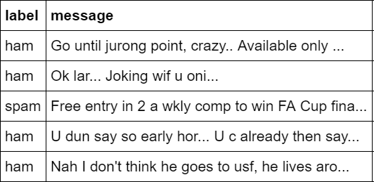
Model Evaluation
Let’s imagine a full data set of Ham vs Spam text messages.

Slide 24
Model Evaluation
Before the split, we have labels and features
Y Label
X Features

Slide 25
Model Evaluation
We call these Y Labels and X Features
Y Label
X Features

Slide 26
Model Evaluation
Before we fit the model, we split the data!
Y Label
X Features

Slide 27
Model Evaluation
Before we fit the model, we split the data!

Slide 28
Model Evaluation
Before we fit the model, we split the data!

Slide 29
Model Evaluation
Before we fit the model, we split the data!
TEST
TRAIN

Slide 30
Model Evaluation
Before we fit the model, we split the data!
Y TEST
X TEST
TEST
Y TRAIN
X TRAIN
TRAIN

Slide 31
Model Evaluation
Notice how after a train test split we always end up with 4 components:
X_train
X_test
Y_train
Y_test

Slide 32
Model Evaluation
These 4 components are simply the result of the train/test split groups being separated between features and labels.
Let’s continue to understand classification process in more detail and metrics to evaluate it!

Slide 33
Classification Metrics

Slide 34
Model Evaluation
We just learned that after our machine learning process is complete, we will use performance metrics to evaluate how our model did.
Let’s discuss classification metrics in more detail!

Slide 35
Model Evaluation
The key classification metrics we need to understand are:
Accuracy
Recall
Precision
F1-Score

Slide 36
Model Evaluation
But first, we should understand the reasoning behind these metrics and how they will actually work in the real world!

Slide 37
Model Evaluation
Typically in any classification task your model can only achieve two results:
Either your model was correct in its prediction.
Or your model was incorrect in its prediction.

Slide 38
Model Evaluation
Fortunately incorrect vs correct expands to situations where you have multiple classes.
For the purposes of explaining the metrics, let’s imagine a binary classification situation, where we only have two available classes.

Slide 39
Model Evaluation
In our example, we will attempt to predict if a text is Spam or Ham (legitimate).
Since this is supervised learning, we will first fit/train a model on training data, then test the model on testing data.
Once we have the model’s predictions from the X_test data, we compare it to the true y values (the correct labels).

Slide 40
Model Evaluation
Keep in mind, there will be a few steps to convert the raw text into a format that the machine learning model can understand.
We will discuss these methods in much more detail later on!

Slide 41


Model Evaluation
Vectorizer
Raw Text
Test Message
from X_test
Vectorized
Test Message
from X_test

Slide 42
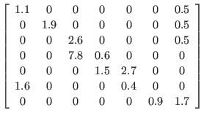
Model Evaluation
Hi! How are you doing? I’ve been doing well. Anyways, feel free to text me back dude!
Vectorizer
Raw Text
Test Message
from X_test
Vectorized
Test Message
from X_test

Slide 43
Model Evaluation
We set up this vectorization in a pipeline and there are many ways of transforming the raw text into numerical information.
For now, let’s focus on the classification process and assume there is some underlying vectorization.

Slide 44
Model Evaluation
TRAINED
MODEL

Slide 45
Model Evaluation
TRAINED
MODEL
Test Message
from X_test

Slide 46
Model Evaluation
TRAINED
MODEL
Test Message
from X_test
HAM
Correct Label
from y_test

Slide 47
Model Evaluation
TRAINED
MODEL
Test Message
from X_test
HAM
Prediction on
Test Message
HAM
Correct Label
from y_test

Slide 48
Model Evaluation
TRAINED
MODEL
Test Message
from X_test
HAM
Prediction on
Test Message
HAM
Correct Label
from y_test
HAM== HAM ?
Compare Prediction to Correct Label

Slide 49
Model Evaluation
TRAINED
MODEL
Test Message
from X_test
SPAM
Prediction on
Test Message
HAM
Correct Label
from y_test
HAM == SPAM ?
Compare Prediction to Correct Label

Slide 50
Model Evaluation
We repeat this process for all the text messages in our X test data.
At the end we will have a count of correct matches and a count of incorrect matches.
The key realization we need to make, is that in the real world, not all incorrect or correct matches hold equal value!

Slide 51
Model Evaluation
Also in the real world, a single metric won’t tell the complete story!
To understand all of this, let’s bring back the 4 metrics we mentioned and see how they are calculated.
We could organize our predicted values compared to the real values in a confusion matrix.

Slide 52
Model Evaluation
Accuracy
Accuracy in classification problems is the number of correct predictions made by the model divided by the total number of predictions.

Slide 53
Model Evaluation
Accuracy
For example, if the X_test set was 100 messages and our model correctly predicted 80 messages, then we have 80/100.
0.8 or 80% accuracy.

Slide 54
Model Evaluation
Accuracy
Accuracy is useful when target classes are well balanced.
In our example, we would have roughly the same amount of spam messages as we have ham messages.

Slide 55
Model Evaluation
Accuracy
Accuracy is not a good choice with unbalanced classes!
Imagine we had 99 legitimate ham messages and 1 spam text message.
If our model was simply a line that always predicted HAM we would get 99% accuracy!

Slide 56
Model Evaluation
Accuracy
Accuracy is not a good choice with unbalanced classes!
Imagine we had 99 legitimate ham messages and 1 spam text message.
In this situation we’ll want to understand recall and precision!

Slide 57
Model Evaluation
Let’s quickly go over some formal definitions of Precision, Recall, and F1-Score (a combination of Precision and Recall).

Slide 58
Model Evaluation
Recall
Ability of a model to find all the relevant cases within a dataset.
The precise definition of recall is the number of true positives divided by the number of true positives plus the number of false negatives.

Slide 59
Model Evaluation
Precision
Ability of a classification model to identify only the relevant data points.
Precision is defined as the number of true positives divided by the number of true positives plus the number of false positives.

Slide 60
Model Evaluation
Recall and Precision
Often you have a trade-off between Recall and Precision.
While recall expresses the ability to find all relevant instances in a dataset, precision expresses the proportion of the data points our model says was relevant actually were relevant.

Slide 61
Model Evaluation
F1-Score
In cases where we want to find an optimal blend of precision and recall we can combine the two metrics using what is called the F1 score.

Slide 62
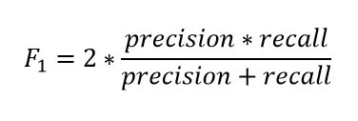
Model Evaluation
F1-Score
The F1 score is the harmonic mean of precision and recall taking both metrics into account in the following equation:

Slide 63
Model Evaluation
F1-Score
We use the harmonic mean instead of a simple average because it punishes extreme values.
A classifier with a precision of 1.0 and a recall of 0.0 has a simple average of 0.5 but an F1 score of 0.

Slide 64
Model Evaluation
Precision and Recall typically make more sense in the context of a confusion matrix.
In the next lecture we will explore the confusion matrix!

Slide 65
Confusion Matrix

Slide 66
Model Evaluation
We mentioned a way to view various metrics of classification is the confusion matrix.
Let’s explore the basics of the confusion matrix.

Slide 67
Model Evaluation
In a classification problem, during the testing phase you will have Two Categories:
True Condition
Predicted Condition

Slide 68
Model Evaluation
In a classification problem, during the testing phase you will have Two Categories:
True Condition
A text message is SPAM
Predicted Condition
ML Model predicted SPAM

Slide 69
Model Evaluation
In a classification problem, during the testing phase you will have Two Categories:
True Condition
A text message is SPAM
Predicted Condition
ML Model predicted HAM

Slide 70
Model Evaluation
This means if you have two possible classes you should have 4 separate groups at the end of testing:
Correctly Classified to Class 1: TRUE HAM
Correctly Classified to Class 2: TRUE SPAM
Incorrectly classified to Class 1: FALSE HAM
Incorrectly classified to Class 2: FALSE SPAM

Slide 71
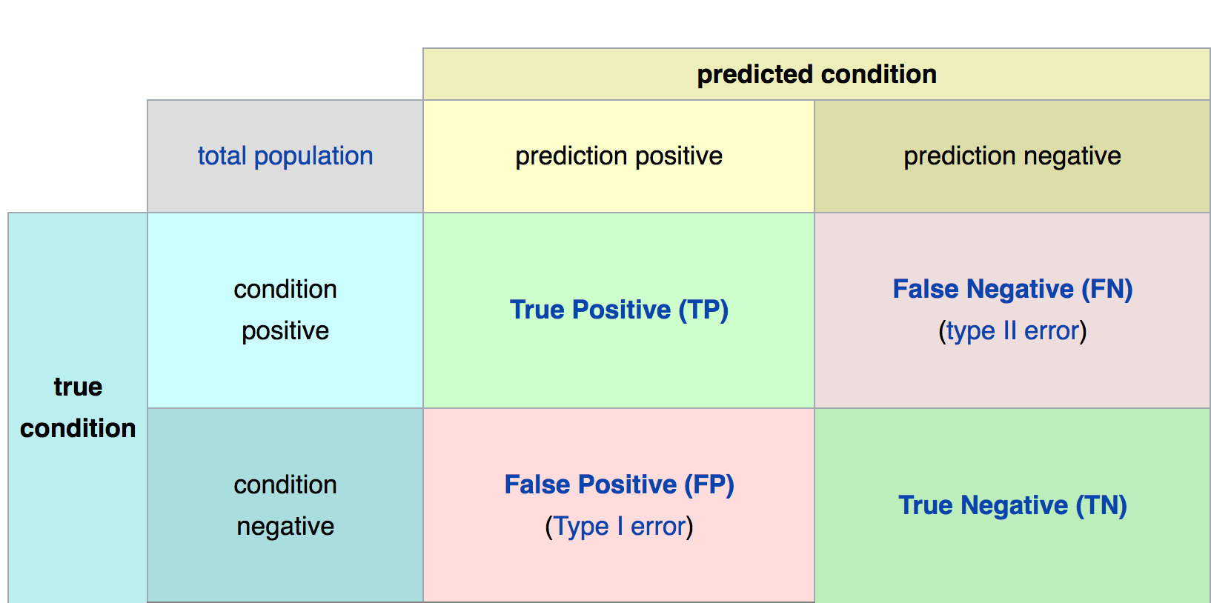
Confusion Matrix
Math &
Statistics
Machine Learning
DS
Software
Research
Domain
Knowledge

Slide 72
Confusion Matrix
 |  | PREDICTED CONDITION
 | ALL TEXTS | PREDICTED HAM | PREDICTED SPAM
REAL CONDITION | REAL CONDITION HAM | TRUE POSITIVE | FALSE NEGATIVE
 | REAL CONDITION SPAM | FALSE POSITIVE | TRUE NEGATIVE
Math &
Statistics
Machine Learning
DS
Software
Research
Domain
Knowledge

Slide 73
Confusion Matrix
Math &
Statistics
Machine Learning
DS
Software
Research
HAM
Domain
Knowledge

Slide 74
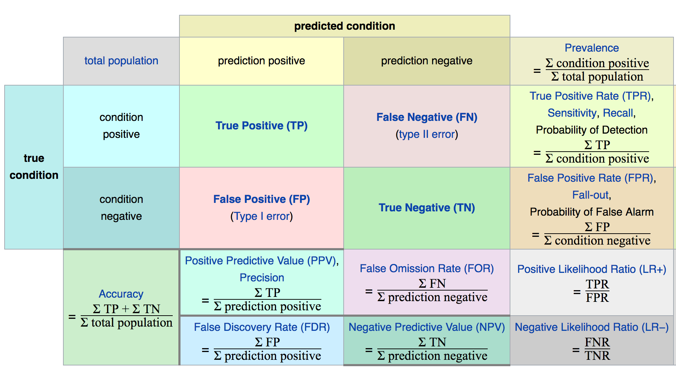
Confusion Matrix
Math &
Statistics
Machine Learning
DS
Software
Research
Domain
Knowledge

Slide 75
Model Evaluation
The main point to remember with the confusion matrix and the various calculated metrics is that they are all fundamentally ways of comparing the predicted values versus the true values.
What constitutes “good” metrics, will really depend on the specific situation!
Math &
Statistics
Machine Learning
DS
Software
Research
Domain
Knowledge

Slide 76
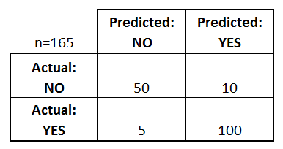
Model Evaluation
We can use a confusion matrix to evaluate our model.
For example, imagine testing for disease.
Math &
Statistics
Machine Learning
Example: Test for presence of disease
NO = negative test = False = 0
YES = positive test = True = 1
DS
Software
Research
Domain
Knowledge

Slide 77
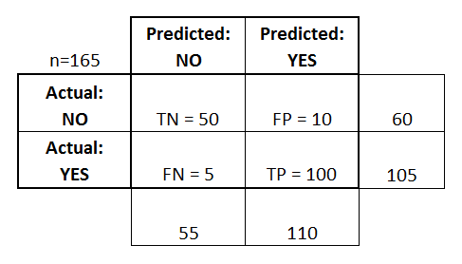
Confusion Matrix
Basic Terminology:
True Positives (TP)
True Negatives (TN)
False Positives (FP)
False Negatives (FN)
Math &
Statistics
Machine Learning
DS
Software
Research
Domain
Knowledge

Slide 78
Confusion Matrix
Math &
Statistics
Machine Learning
Accuracy:
Overall, how often is it correct?
(TP + TN) / total = 150/165 = 0.91
DS
Software
Research
Domain
Knowledge

Slide 79
Confusion Matrix
Misclassification Rate (Error Rate):
Overall, how often is it wrong?
(FP + FN) / total = 15/165 = 0.09
Math &
Statistics
Machine Learning
DS
Software
Research
Domain
Knowledge

Slide 80
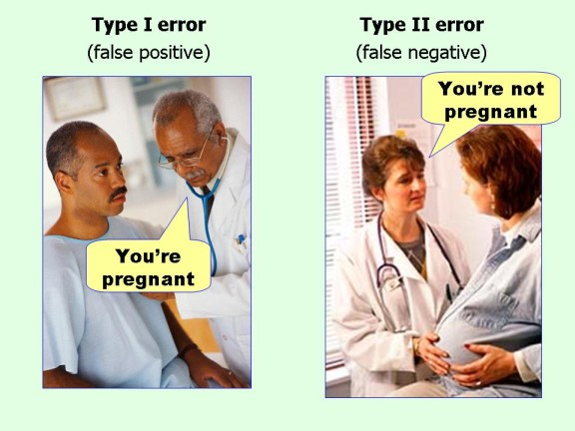
Confusion Matrix
Math &
Statistics
Machine Learning
DS
Software
Research
Domain
Knowledge

Slide 81
Model Evaluation
Still confused on the confusion matrix?
No problem! Check out the Wikipedia page for it, it has a really good diagram with all the formulas for all the metrics.
Throughout the training, we’ll usually just print out metrics (e.g. accuracy).
Math &
Statistics
Machine Learning
DS
Software
Research
Domain
Knowledge

Slide 82
Scikit-Learn Primer

Slide 83
Scikit Learn
We will be using the Scikit Learn package.
It’s the most popular machine learning package for Python and has a lot of algorithms built-in!

Slide 84
Scikit Learn
If you aren’t using our provided .yml environment file you may need to install it using:
conda install scikit-learn
or
pip install scikit-learn

Slide 85
Scikit Learn
Let’s talk about the basic structure of how to use Scikit Learn!
First, a quick review of the machine learning process.

Slide 86
Machine Learning Process
Test
Data
Model
Training &
Building
Data
Acquisition
Data
Cleaning
Model
Testing
Model
Deployment

Slide 87
Scikit Learn
Now let’s go over an example of the process to use SciKit Learn.
Don’t worry about memorizing any of this, we’ll get plenty of practice and review when we actually start coding in subsequent lectures!

Slide 88
Scikit Learn
Every algorithm is exposed in scikit-learn via an ''Estimator''
First you’ll import the model, the general form is:
from sklearn.family import Model
For example:
from sklearn.linear_model import LinearRegression

Slide 89
Scikit Learn
Estimator parameters: All the parameters of an estimator can be set when it is instantiated, and have suitable default values.
You can use Shift+tab in jupyter to check the possible parameters.

Slide 90
Scikit Learn
For example:
model = LinearRegression(normalize=True)
print(model)
LinearRegression(copy_X=True, fit_intercept=True, normalize=True)

Slide 91
Scikit Learn
Once you have your model created with your parameters, it is time to fit your model on some data!
But remember, we should split this data into a training set and a test set.

Slide 92
Scikit Learn
>>> import numpy as np >>> from sklearn.model_selection import train_test_split >>> X, y = np.arange(10).reshape((5, 2)), range(5) >>> X array([[0, 1], [2, 3], [4, 5], [6, 7], [8, 9]]) >>> list(y) [0, 1, 2, 3, 4]

Slide 93
Scikit Learn
>>> X_train, X_test, y_train, y_test = train_test_split(X, y,test_size=0.3) >>> X_train array([[4, 5], [0, 1], [6, 7]]) >>> y_train [2, 0, 3] >>> X_test array([[2, 3], [8, 9]]) >>> y_test [1, 4]

Slide 94
Scikit Learn
Now that we have split the data, we can train/fit our model on the training data.
This is done through the model.fit() method:
model.fit(X_train,y_train)

Slide 95
Scikit Learn
Now the model has been fit and trained on the training data.
The model is ready to predict labels or values on the test set!

Slide 96
Scikit Learn
We get predicted values using the predict method:
predictions = model.predict(X_test)

Slide 97
Scikit Learn
We can then evaluate our model by comparing our predictions to the correct values.
The evaluation method depends on what sort of machine learning algorithm we are using (e.g. Regression,Classification, Clustering, etc.)

Slide 98
Scikit-Learn Primer
Coding Lecture

Slide 99
Feature Extraction
From Text
Part One

Slide 100
Natural Language Processing Bootcamp
Most classic machine learning algorithms can’t take in raw text.
Instead we need to perform a feature “extraction” from the raw text in order to pass numerical features to the machine learning algorithm.

Slide 101
Natural Language Processing Bootcamp
For example, we could count the occurence of each word to map text to a number.
Let’s discuss Counter Vectorization along with Term-Frequency and Inverse Document Frequency.

Slide 102
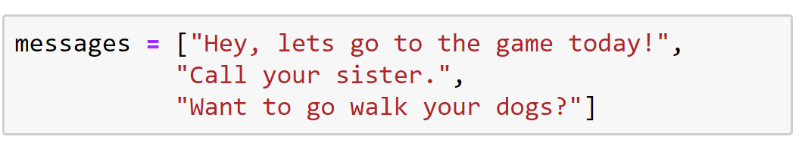
Natural Language Processing Bootcamp
Count Vectorization

Slide 103
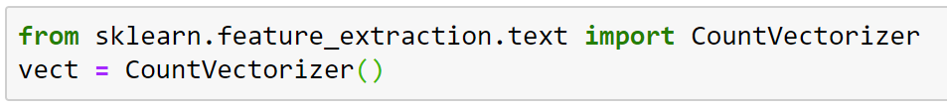
Natural Language Processing Bootcamp
Count Vectorization

Slide 104
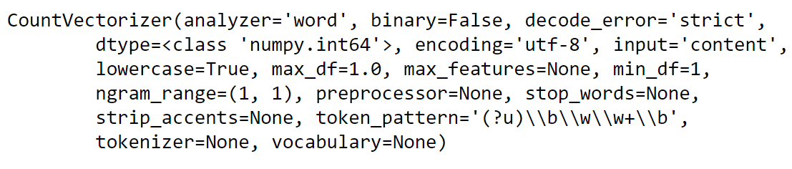
Natural Language Processing Bootcamp
Count Vectorization

Slide 105
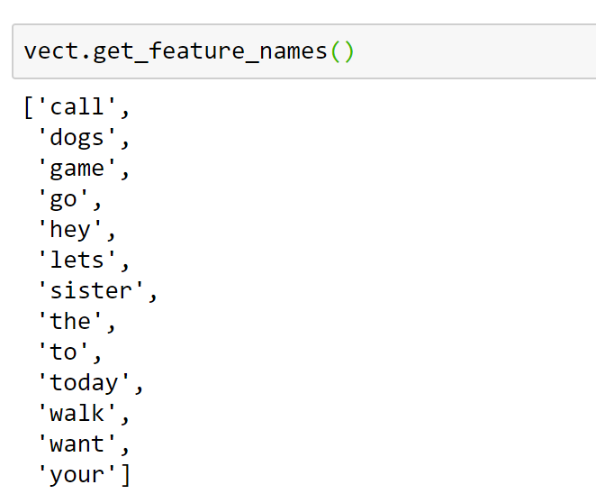
Natural Language Processing Bootcamp
Count Vectorization

Slide 106
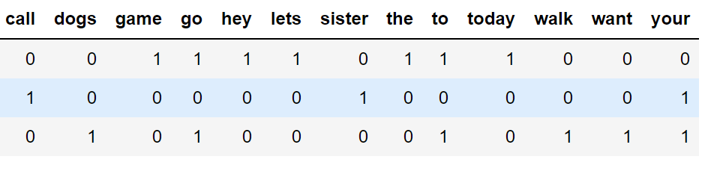
Natural Language Processing Bootcamp
Document Term Matrix (DTM)

Slide 107
Natural Language Processing Bootcamp
An alternative to CountVectorizer is something called TfidfVectorizer. It also creates a document term matrix from our messages.
However, instead of filling the DTM with token counts it calculates term frequency-inverse document frequency value for each word(TF-IDF).

Slide 108
Natural Language Processing Bootcamp
Term frequency tf(t,d): is the raw count of a term in a document, i.e. the number of times that term t occurs in document d.

Slide 109
Natural Language Processing Bootcamp
However, Term Frequency alone isn’t enough for a thorough feature analysis of the text!
Let’s imagine very common terms, like “a” or “the”...

Slide 110
Natural Language Processing Bootcamp
Because the term "the" is so common, term frequency will tend to incorrectly emphasize documents which happen to use the word "the" more frequently, without giving enough weight to the more meaningful terms "red" and "dogs".

Slide 111
Natural Language Processing Bootcamp
An inverse document frequency factor is incorporated which diminishes the weight of terms that occur very frequently in the document set and increases the weight of terms that occur rarely.

Slide 112
Natural Language Processing Bootcamp
It is the logarithmically scaled inverse fraction of the documents that contain the word (obtained by dividing the total number of documents by the number of documents containing the term, and then taking the logarithm of that quotient)

Slide 113
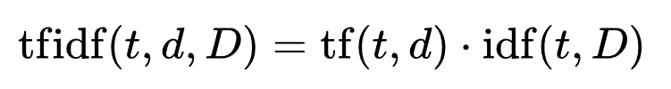
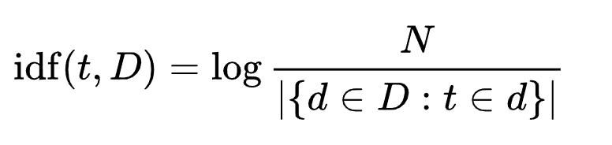
Natural Language Processing Bootcamp
TF-IDF = term frequency * (1 / document frequency)
TF-IDF = term frequency * inverse document freq

Slide 114
Natural Language Processing Bootcamp
Fortunately Scikit-learn can calculate all these terms for us through the use of its API.
Notice how similar the syntax is to our previous use of ML models in Scikit-Learn!

Slide 115
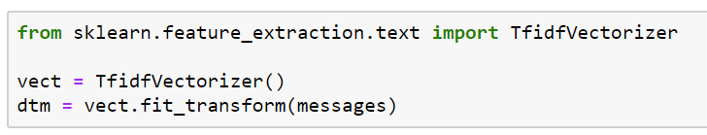
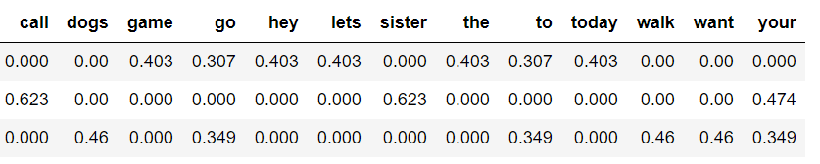
Natural Language Processing Bootcamp

Slide 116
Natural Language Processing Bootcamp
TF-IDF allows us to understand the context of words across an entire corpus of documents, instead of just its relative importance in a single document.
Coming up next we’ll explore how to perform these operations with Python and SciKit-Learn!

Slide 117
Feature Extraction
From Text
Continued

Slide 118
Natural Language Processing Bootcamp
In this lecture we will learn:
A basic manual implementation of building a vocabulary
Using Scikit-learn for vectorization
Using Pipelines with Scikit-Learn

Slide 119
Feature Extraction
From Text
Part Three - Code Along

Slide 120
Text Classification Code Along Project
Part One

Slide 121
Natural Language Processing Bootcamp
Now that we understand the general machine learning process, classification metrics, and scikit-learn, let’s combine all these concepts by coding along with a real text data set!

Slide 122
Text Classification Assessment Overview

Slide 123
Text Classification Assessment Solutions

